Slide 1



Slide 2



Safety Orientation
OBJECTIVES
Teacher Safety
Hazardous Chemicals
Bloodborne Pathogens
Preventing Slips, Trips, & Falls
Preventing Back Injuries
Fire Prevention & Response

Slide 3



Slide 4
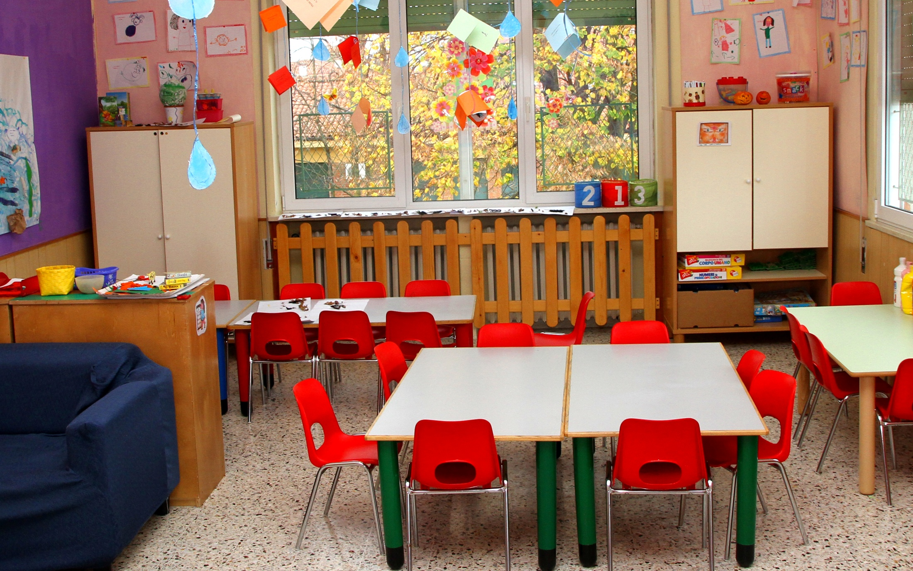
Classroom Safety
DECORATING
1
Only use decorations for their intended purpose.
Do not block fire alarms, windows, or exits.
Avoid hanging decorations from lights, sprinklers, vents, or radiators.
Secure all decorations to the wall to minimize fire hazards.
Never stand on desks, chairs, or furniture to hang decorations.
2
3
4
5

Slide 5

Classroom Safety
HOUSEKEEPING
1
Keep floors free from clutter and tripping hazards.
Organize your room where items such as backpacks and supplies have a safe location out of pathways.
Keep cabinets and drawers closed when not in use.
Ensure shelves and bulletin boards are safely secured.
Keep desks spaced to allow adequate walking room.
2
3
4
5

Slide 6


Safety Awareness
BACK TO SCHOOL
What do you think is the most common “back to school” teacher injury?

Slide 7

Safety Awareness
BACK TO SCHOOL
# INJURY
Falls from standing on chairs, desks, or furniture to hang decorations or reach items.
*Based on CAS claims data.

Slide 8

Safety Awareness
BACK TO SCHOOL
SOLUTION
Always use safe ladders to hang decorations or to reach high items.

Slide 9

Classroom Safety
EMERGENCY PROCEDURES
1
Ensure regular training/testing is done on your district’s emergency response plans.
Report suspicious behavior to administration quickly.
Educate your students on the emergency response plan.
Know the locations of fire extinguishers and how to use them properly.
Keep a first-aid kit in your classroom.
2
3
4
5

Slide 10




Slide 11
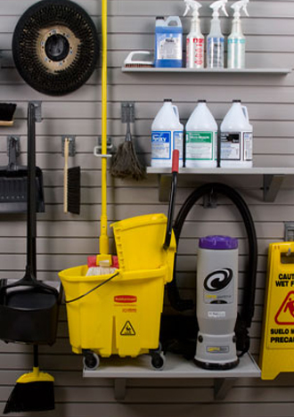
Hazardous Chemical Safety
STORAGE AND USE
1
Use school-provided cleaners that contain proper labeling.
Store all hazardous chemicals in a locked cabinet away from students.
Ensure you have access to and have read the Safety Data Sheets (SDS) for all chemicals you use at work.
Follow all instructions on SDS for usage, storage, disposal, and emergency procedures.
2
3
4

Slide 12
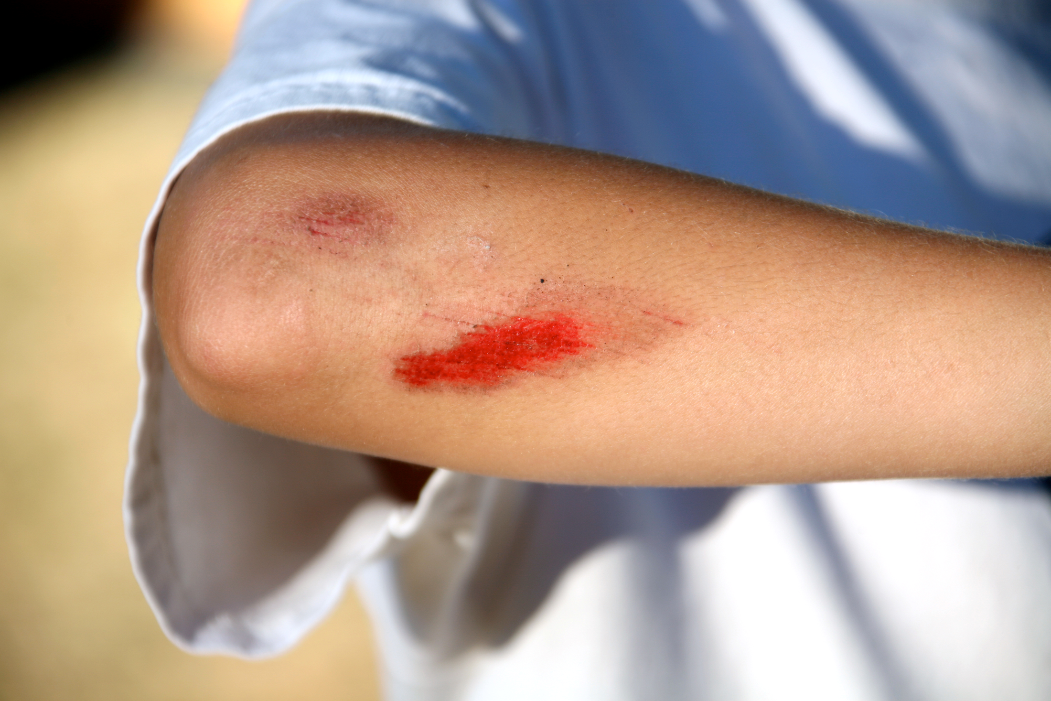


Slide 13

Bloodborne Pathogen Safety
EXPOSURE
1
Treat all blood and bodily fluid as if they are infected.
Occupationally exposed employees should be vaccinated for Hepatitis B.
Wash your hands often, use personal protective equipment, and keep your work area clean.
Notify your supervisor immediately if exposure occurs.
2
3
4

Slide 14

Bloodborne Pathogen Safety
CLEANING
1
Disinfect contaminated surfaces with a bleach solution or EPA approved disinfectant.
Cleaner should sit for ten minutes on the area before removing.
Scrub the surface completely.
Any equipment used to aid in the cleanup must be sanitized.
Discard of exposed materials and take out trash immediately in biohazard bags.
2
3
4

Slide 15



Slide 16


Preventing Slips, Trips, & Falls
LOOK AHEAD FOR HAZARDS
1
Watch for uneven surfaces such as curbs, cracks, steps, and stairs.
Make sure all debris and clutter are cleared from work areas and walkways.
Wear slip-resistant shoes that are safe for the job you are doing.
Secure all cords and wires to the floor away from pathways.
2
3
4

Slide 17
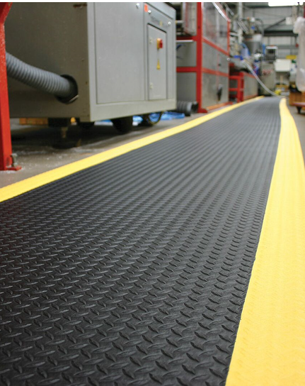

Preventing Slips, Trips, & Falls
FLOOR SURFACES
1
Use walk-off mats that have slip-resistant backing.
Replace any mats that have been torn, or that don't lie flat.
Make sure mats are securely placed onto the floor.
Use safety mats at door entrances & areas that often get wet or slippery.
Clean up spills immediately, and block off hazardous areas with safety signs.
2
3
4
5

Slide 18

Ladder Safety
USAGE
1
Choose the right ladder for the job.
Inspect ladder before using it and always follow the ladder’s instruction labels.
Place your ladder on firm, level ground, away from doors.
Stay off of the ladder’s top step and bucket shelf.
Put ladders away when they are not in use.
2
3
4
5

Slide 19



Slide 20

Preventing Back Injuries
LIFTING BASICS
1
Assess the load: How heavy is it? How far do you have to carry it?
Position your feet shoulder-width apart, one foot ahead of the other.
Bend your knees, keeping your back straight.
Grab opposite corners of the load with a firm grip.
Hug the load, keeping it close to your body.
2
3
4
5

Slide 21
Preventing Back Injuries
LIFTING BASICS
6
Lift with your legs, not your back.
When handling the load, avoid twisting your body.
Ask for help with heavy or bulky loads.
Use equipment such as dollies & forklifts when needed.
7
8
9
Do not ignore the signs and symptoms of back injury.

Slide 22
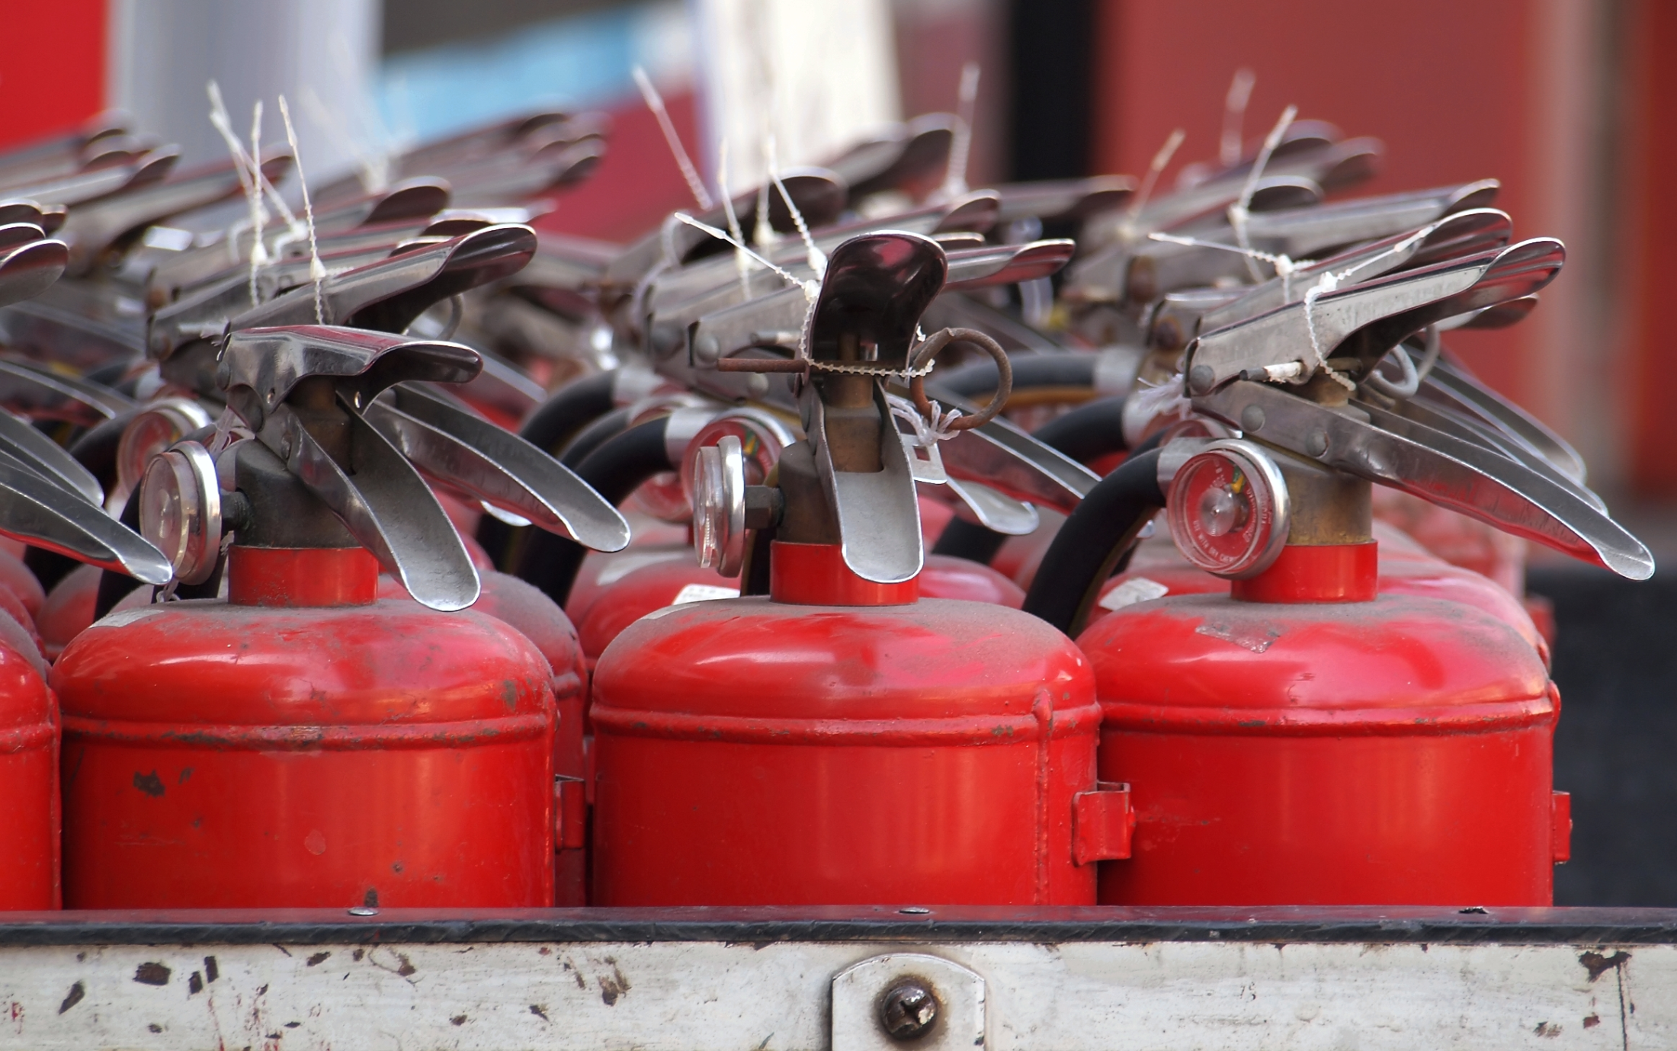


Slide 23

Electrical Safety
CORDS, OUTLETS, & APPLIANCES
1
Only use school-provided extension cords.
Avoid overloading outlets or extension cords.
Do not hang cords on walls, or put them under rugs.
Inspect cords and wires before using, do not use them if they are damaged.
All space heaters and appliances must be approved by administration.
2
3
4
5

Slide 24


Fire Safety
EXTINGUISHER TYPES
Fires are generally grouped into 5 types based off the fuel the fire is using. Each type of fire has specific properties and there are extinguishers for each type.
Fire extinguishers will have a label on them letting you know what types of fires they are effective against.

Slide 25



Fire Safety
EXTINGUISHER TYPES
Always make sure the extinguisher you choose is the correct type for the fire.
If you have any doubt, DO NOT USE.

Slide 26
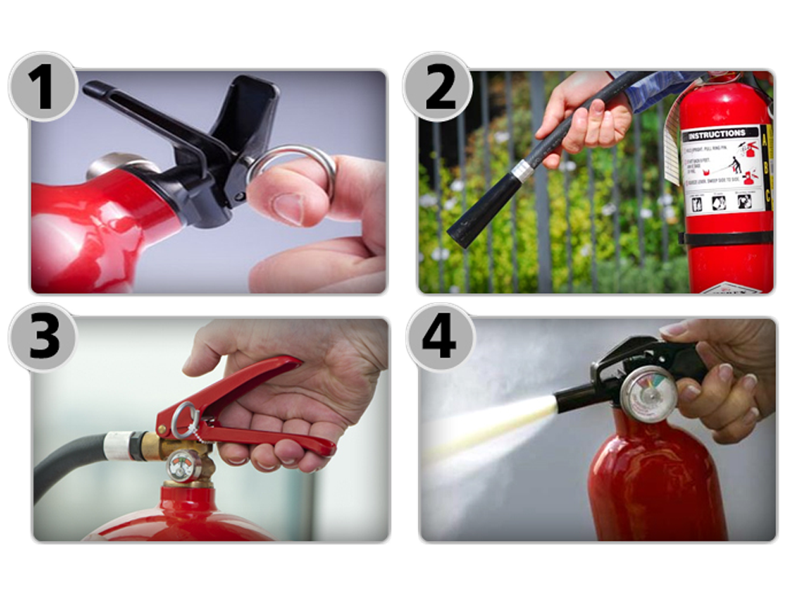
Fire Safety
EXTINGUISHER USAGE: PASS METHOD
PULL THE PIN
AIM AT THE BASE
SQUEEZE THE HANDLE
SWEEP SIDE TO SIDE

Slide 27


As part of our service to you, we are here to help with all of your safety training needs.
Our services
include:

Slide 28
Onsite Consulting & Training
Streaming Safety Videos
Online Training Courses
Administration Guides
Safety Management Toolkits
Supervisor Training Manuals
(by department)
Employee Safety Rules
(by department)
Safety Awareness Posters
Monthly Safety Newsletters
Safety Meeting Guides

